Slide 1

Slide Title
...

Slide 2
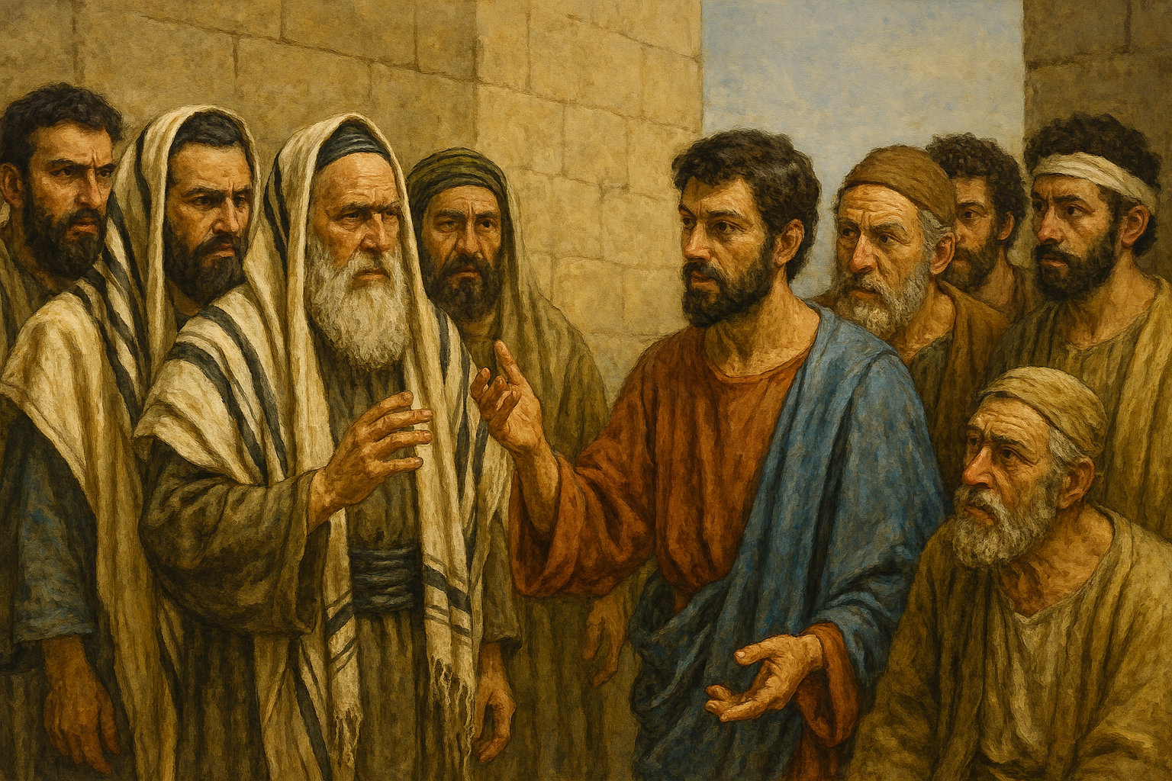
Acts, part 1
Lesson 9
Acts 6

Slide 3
Multiplying disciples; problem
First time called “disciples”
Church is growing, increasing
  Difference in true growth and “swelling”
Growth can bring problems (Acts 20:28-31)
  Different personalities, ethnicity, customs
Murmuring (NKJV, ESV—complaint)
Against Hebrews by the Hellenists
Notes:
Ac 6:1 Now in those days, when the number of the disciples was multiplying, there arose a complaint against the Hebrews by the Hellenists, because their widows were neglected in the daily distribution. (Grecian Jews)
Up to now Luke has spoken of the harmony that existed among the brethren (1:14; 2:1; 4:24, 32; 5:12)
Coffman—
Grecian Jews against the Hebrews ... Both classes of these "Jews" were Christians [gospel had not been preached to Gentiles—Acts 10], but there was a language barrier. The Jews of Palestine spoke Aramaic, and those of the Diaspora spoke Greek; many of the latter were living in Jerusalem at that time but were natives of the provinces.
Barnes—
Dissensions would be very likely to arise between these two classes of persons. The Jews of Palestine would pride themselves much on the fact that they dwelt in the land of the patriarchs, and the land of promise; that they used the language which their fathers spoke, and in which the oracles of God were given; and that they were constantly near the temple, and regularly engaged in its solemnities. On the other hand, the Jews from other parts of the world would be suspicious, jealous, and envious of their brethren, and would be likely to charge them with partiality, or of taking advantage in their intercourse with them. These occasions of strife would not be destroyed by their conversion to Christianity, and one of them is furnished on this occasion.
1Co 3:3 for you are still carnal. For where there are envy, strife, and divisions among you, are you not carnal and behaving like mere men?
(works of flesh) Ga 5:20 idolatry, sorcery, hatred, contentions, jealousies, outbursts of wrath, selfish ambitions, dissensions, heresies,
Php 2:3 Let nothing be done through selfish ambition or conceit, but in lowliness of mind let each esteem others better than himself.
Php 2:14 Do all things without complaining and disputing
1Pe 4:9 Be hospitable to one another without grumbling.

Slide 4
Apostles’ solution
The twelve
Continue in work of teaching
  Not serve in food distribution
What they did not do
  They were not using food to attract people to teach
  Rather, those taught needed assistance with physical needs
Solution—church would handle it from within
Notes:
Ac 6:2 Then the twelve summoned the multitude of the disciples and said, "It is not desirable that we should leave the word of God and serve tables.
As Brother Harkrrider comments, the church in Jerusalem did not originate a program of benevolence as a means of evangelizing, but simply cared for its own.
Wayne Partain—
The first problem in the church was caused by cultural differences. Although the Hebrew and Greek brothers had much in common, there were differences and cultural conflicts between them. Many do not abandon their cultural differences and prejudices when they obey the gospel.
The money from the properties sold was given to the apostles (4:32-35), but we are ignorant of the distribution process. The Hellenists accuse the Hebrews of discrimination. When there are problems of this kind, is it appropriate to gossip and accuse of this kind? Wouldn't it be better to explain the problem in a brotherly way? It would be very difficult to believe that the apostles or other Hebrew brethren would want to neglect Hellenistic widows.

Slide 5
Administered from within
Pick from among you
Seven men—
  Good reputation
  Full of Holy Spirit
  Full of wisdom
Appoint these to handle the food distribution
We will continue in prayer and teaching
DEACONS??
Notes:
Ac 6:3 "Therefore, brethren, seek out from among you seven men of good reputation, full of the Holy Spirit and wisdom, whom we may appoint over this business;
4 "but we will give ourselves continually to prayer and to the ministry of the word.“
Barnes—
The word "serve" has the meaning of "minister to," and is rendered from the Greek word [@diakonia], a derivative from [@diakonos], the latter term being
rendered "by three English words in our version: MINISTER; SERVANT, and DEACON."[6] It is upon this rather precarious basis that the men here appointed are often called "deacons." Significantly, the record here does not so name them, nor is there very much similarity between their status and that of the deacons Paul commanded Timothy to appoint.

Slide 6
Everyone pleased
Steven
Philip
Prochorus
Nicanor
Timon
Parmenas
Nicolas
Notes:
Ac 6:5 And the saying pleased the whole multitude. And they chose Stephen, a man full of faith and the Holy Spirit, and Philip, Prochorus, Nicanor, Timon, Parmenas, and Nicolas, a proselyte from Antioch,
6 whom they set before the apostles; and when they had prayed, they laid hands on them.
WayneP—
Stephen, a man full of faith and the Holy Spirit, Philip (8:5-40; 21:8, not Philip the apostle but Philip the evangelist who brought the gospel to Samaria, converted the eunuch, and lived and worked in Caesarea), Prochorus, Nicanor, Timon, Parmenas, and Nicholas, proselyte of Antioch; -Of the other five, apart from Stephen and Philip, we know nothing. There are theories about Nicanor [Nicolas ??—wmh] (his name is connected to the Nicolaitans, Rev. 2:6), but they are pure baseless speculations. These are Greek names and if pure Hellenists were chosen this would indicate a great effort to please those who complained but, on the other hand, it has been commented that some Jews of Palestine bore Greek names.
To church at Ephesus -- Re 2:6 "But this you have, that you hate the deeds of the Nicolaitans, which I also hate.
Coffman—
Two of the Ante-Nicene writers connected the name of Nicolaus with the heresy named in Revelation 2:6. Irenaeus wrote:
The Nicolaitanes are the followers of that Nicolaus who was one of the seven first ordained to the diaconate by the apostles. They lead lives of unrestrained indulgence ... teaching that it is a matter of indifference to practice adultery, and to eat things sacrificed to idols.[11]
Of course, it is no greater wonder that one of the Seven should have proved to be unworthy than that one of the Twelve should have been a traitor. Nevertheless, serious doubt is cast upon Irenaeus' charge of heresy against Nicolaus, it being far more likely that a group of sinners pretending to be his followers adopted his name in an effort to further their evil teaching, as appears in this comment from Victorinus who wrote the first known commentary on Revelation. In his comment on Revelation 2:6, he said:
The Nicolaitanes were in that time false and troublesome men, who, as ministers under the name of Nicolaus, had made for themselves a heresy

Slide 7
Disciples multiplied greatly
Internal problem solved
Word of God spread
Still in Jerusalem
Great many priest obedient to the faith
  Obedient to the gospel
  Facts to be believed
  Commandments to be obeyed
  Promises to enjoy
Notes:
Ac 6:7 Then the word of God spread, and the number of the disciples multiplied greatly in Jerusalem, and a great many of the priests were obedient to the faith.
Murmurings and dissensions destroy the work, but unity promotes it.
many of the priests also obeyed the faith. - This was quite significant. It was a sad day for Annas, Caiaphas, and the entire sect of the Sadducees (5:17). On one occasion the chief priests and Pharisees asked in a mocking tone, "Has any of the rulers, or of the Pharisees, believed in him?" (John 7:48). Here is the answer: "Many of the priests also obeyed the faith."
." How is it possible to "obey the faith"? If we speak as the Bible speaks, we will say that "faith" in this text is the gospel, what we believe in. It means the same thing in Gal. 3:25; Efes. 4:5; Jude 3; and other texts. It says Rom. 1:5, "And through whom we receive grace and apostleship for the obedience of faith," and again in Rom. 16:26, "He has made himself known to all nations that they may obey the faith."
Therefore, when the gospel is preached, it is necessary to announce that there is something to obey, something to do, and even though it is denied by 10,000 evangelical pastors who believe in salvation by faith alone, these texts say that what we have to be obedient to is "faith." The gospel contains (1) facts to believe, (2) commandments to obey, and (3) promises to enjoy.
Coffman—
Obedient to the faith ... Here is another outcropping of that fundamental fact of the New Testament, making "faith" not a subjective thing at all but an objective obedience of the gospel commandments. As De Welt said: We must not overlook the expression, "obedient to the faith." There was something
more to their faith than mere mental assent; there was something in it that demanded obedience ... repentance and baptism ... for the remission of sins.[18]
"This obedience is rendered not by believing; for that is to exercise the faith, not to obey it."[19] Wherever faith is mentioned in the New Testament as the basis of God’s forgiveness, remission of sins, or justification, it is invariably an "obedient faith" which is meant. See Romans 1:5 and Romans 16:26.

Slide 8
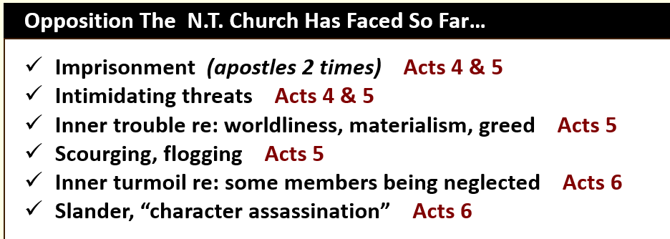
Recorded opposition thus far
Notes:
Chart from Jeff Smith

Slide 9
Disputing with Stephen
Stephen full of faith and power
  Doing great wonders and signs
Freedmen (and others)
  Jewish slaves freed by Rome
Disputed with Stephen
Not able to resist the wisdom and the Spirit
Notes:
Ac 6:8 And Stephen, full of faith and power, did great wonders and signs among the people.
9 Then there arose some from what is called the Synagogue of the Freedmen (Cyrenians, Alexandrians, and those from Cilicia and Asia), disputing with Stephen.
10 And they were not able to resist the wisdom and the Spirit by which he spoke.
From Jeff’s ppt—
Stephen’s description vv. 5, 8
Full of the Holy Spirit being a Spirit-led individual (1 Cor. 2:9-15), or possessing the fruit of the Spirit (Gal 5:22-23) [not describing miraculous power; this description was given before the apostles laid their hands on him]
Full of faith a dedicated believer of Jesus Christ Jn 8:24 Heb 11:6
Full of grace having God’s grace (Eph 2:8), or graceful to others
Full of power miraculous ability to perform signs & wonders [connected to apostolic hands laid upon him]
It is certain that there was a large number of synagogues at Jerusalem. The common estimate is, that there were four hundred and eighty in the city.
[OR rather than freed slaves—Barnes] another and more probable opinion is, that they took their name from some place which they occupied. This opinion is more probable, from the fact that all the other persons mentioned here are named from the countries which they occupied. Suidas says that this is the name of a place.
Barnes—
The wisdom. This properly refers to his knowledge of the Scriptures; his skill in what the Jews esteemed to be wisdom--acquaintance with their sacred writings, opinions, etc.
And the spirit. This has been commonly understood of the Holy Spirit, by which, he was aided; but it rather means the energy, power, or ardour of Stephen. He evinced a spirit of zeal and sincerity which they could not withstand; which served, more than mere argument could have done, to convince them that he was right.

Slide 10
Secretly instigated men (ESV)
Secretly induced (NKJV)
Suborned men (KJV)
Spanish translates to “bribed”
Blasphemous words against Moses and God
Stirred up people
Brought Stephen to the council
Notes:
Ac 6:11 Then they secretly induced men to say, "We have heard him speak blasphemous words against Moses and God."
12 And they stirred up the people, the elders, and the scribes; and they came upon him, seized him, and brought him to the council.
WayneP—
The word bribed means that they were brought under their control with money. Compare the accusations made against Jesus (Matt. 26:65; Mark 2:7). Why did they fabricate this accusation? Because they were determined to kill Stephen and the law said, "Whoever blasphemes the name of the Lord must be put to death; the whole congregation will stone him." —Lev. 24:16; Deut. 13:6-10) Thus begins the process leading to Stephen's death.
Coffman—
They suborned men ... Men do not need to be bribed to tell the truth; and the Pharisees' money in view in this verse is proof enough that the testimony procured by it was false; but such is the mystery of evil that in every generation there must be champions of every lie Satan ever invented.
Google-
In a biblical context, to be suborned means to be secretly instigated, bribed, or induced to commit an unlawful act or give false testimony, often to deceive others or to accuse someone unjustly. The term originates from Latin, meaning to "furnish secretly" and is linked to concepts of collusion, bribery, and false witness, which are condemned throughout the Bible. A key example is King Ahab's wife, Jezebel, suborning false witnesses to falsely accuse Naboth of blasphemy and have him stoned to death.
Understanding "Suborn" in a Biblical Context
Secrecy and Deceit:
The core idea of suborning involves a hidden, underhanded approach to incite someone to do wrong.
Inducing Falsehood:
It specifically refers to persuading someone to provide dishonest information, often in a legal or judicial setting.
Perjury:
A common and severe form of suborning involves bribing or pressuring someone to take a false oath, a crime known as perjury.
Unlawful Actions:
Beyond false oaths, the term can also refer to being secretly encouraged to commit any criminal or wicked deed.
Coffman—
On the face of it, the lying charge that Stephen had blasphemed either God or Moses was unsupported by any fact whatever. As De Welt expressed it: "The accusation was nothing but a black lie"; and we might add that the falsity of the charges was matched by the deceit of the suborned witnesses pretending to have "heard" Stephen say things, despite the probability that they had "heard" nothing at all, but were told what to say by the paymasters procuring the perjury. By definition, "suborned witnesses" are "false witnesses.“

Slide 11
Stephen is accused
False witnesses
We have heard him say…
Jesus vs Moses
They saw his face as the face of an angel
Notes:
Ac 6:13 They also set up false witnesses who said, "This man does not cease to speak blasphemous words against this holy place and the law;
14 "for we have heard him say that this Jesus of Nazareth will destroy this place and change the customs which Moses delivered to us."
15 And all who sat in the council, looking steadfastly at him, saw his face as the face of an angel.
Joh 2:19 Jesus answered and said to them, "Destroy this temple [who destroy it??-wmh], and in three days I will raise it up."
20 Then the Jews said, "It has taken forty-six years to build this temple, and will You raise it up in three days?"
21 But He was speaking of the temple of His body.
Coffman--Change the customs ... Only malignant spite could construe Stephen's preaching the very changes God himself had prophesied in the Old Testament Scriptures as blasphemy, either of God or Moses.
From Jeff’s ppt—
Stephen having been falsely accused, the Sanhedrin looked upon him and noticed his appearance v. 15
–Likely not referencing an angelic “halo-like glow” about him
–Luke could simply be referencing his calm & confident demeanor as he was fully aware of what was happening to him
–He was preparing to speak in his own defense

Slide 12
Slide Title
...

